Slide 1
Roaming through Fantasy Land Does AR/VR Bring New Museum Experience?
James Quo-Ping LIN
Chief, Division of Marketing, Licensing, and Merchandizing
National Palace Museum, Taipei, Taiwan

Slide 2
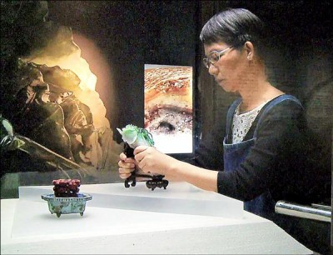
The Desire of Holding a National Treasure
The desire of holding a national treasure never been fulfilled
Museum professionals are still struggling on this direction
The NPM started this adventure since year 2004 with a 3D Virtual Exhibition System

Slide 3
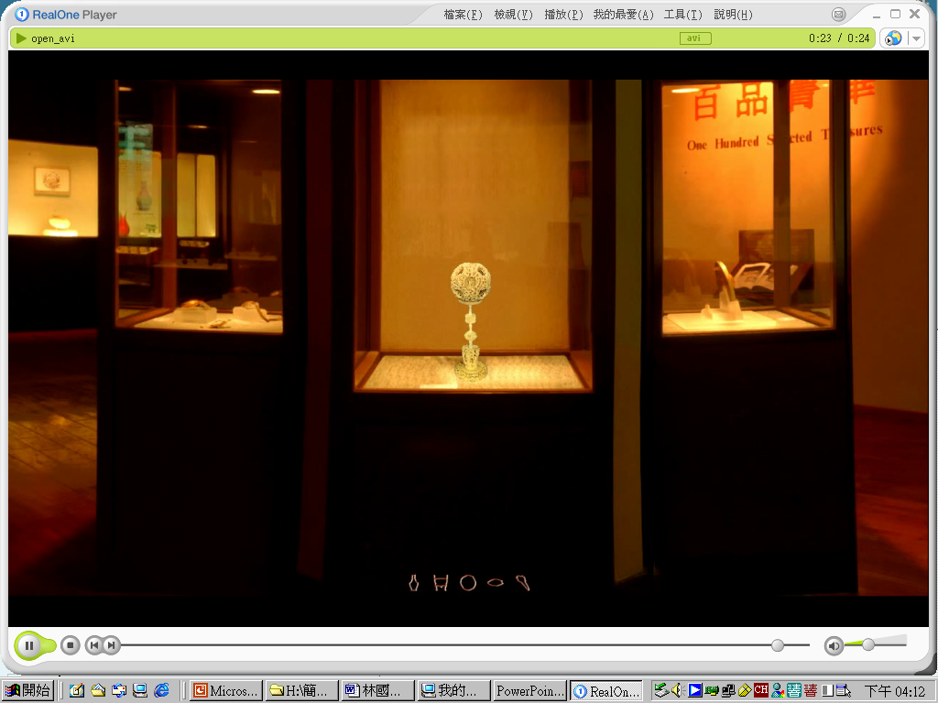
3D Virtual Exhibition System
Cooperation with several research institutions
Based on panorama photo taking techniques
Picked five most interesting artifacts

Slide 4
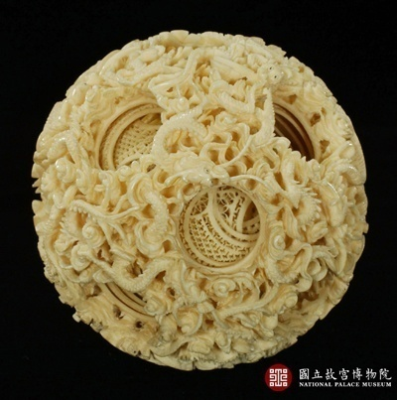
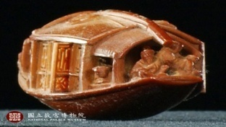
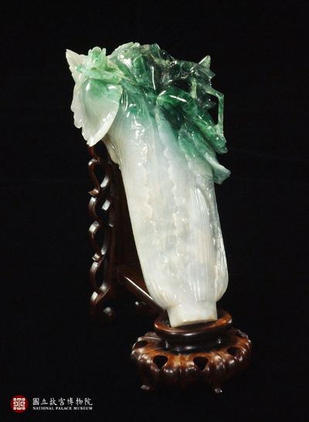
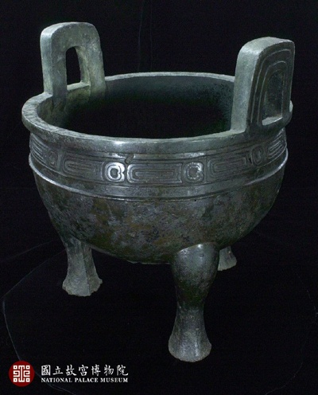
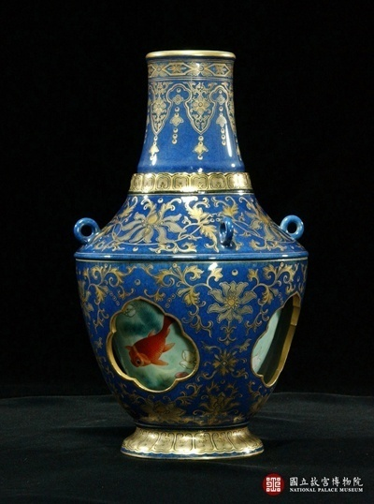
3D Virtual Exhibition System
雕橄欖核小舟
五項精選文物
象牙球
轉心瓶
翠玉白菜
毛公鼎

Slide 5
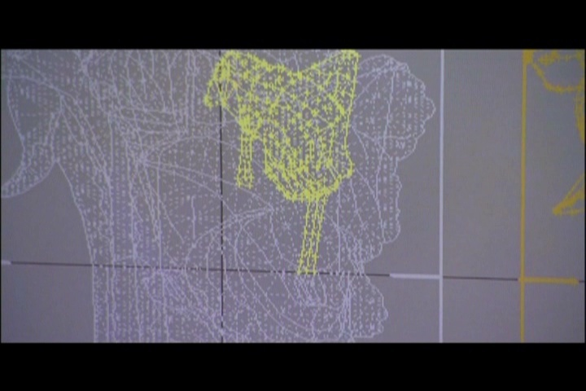
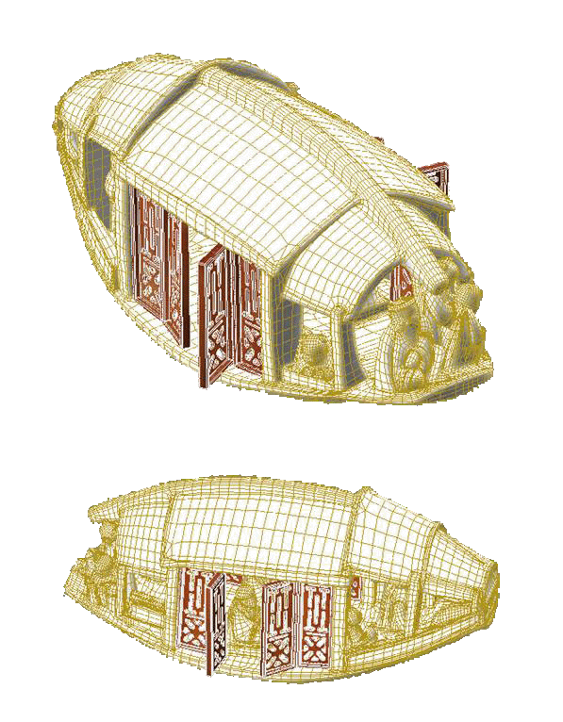
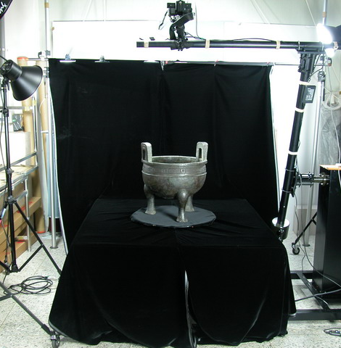

Slide 6
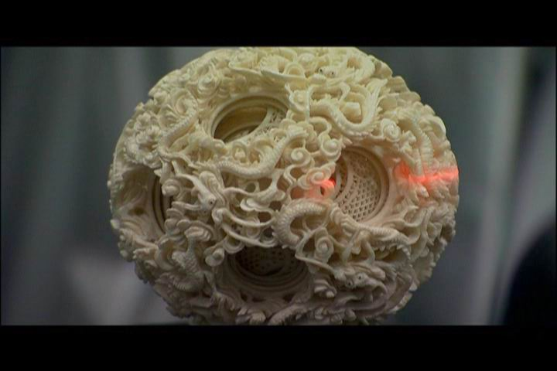
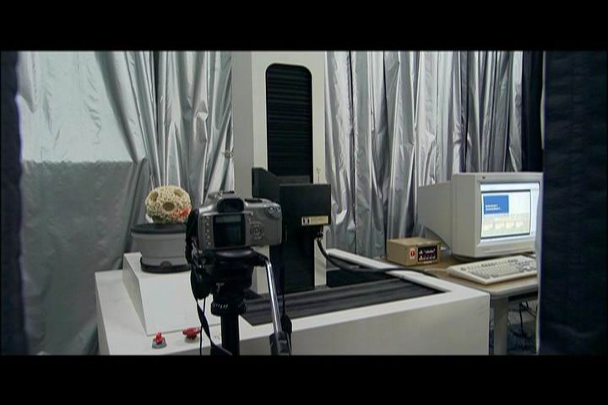
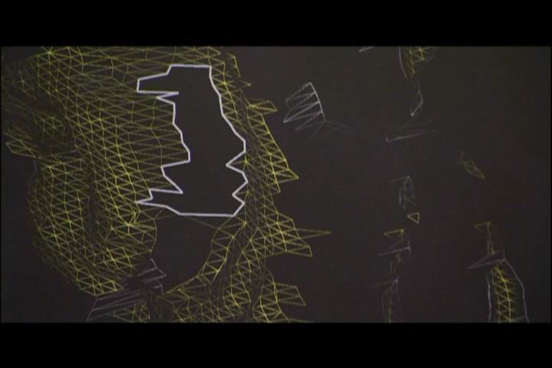
３Ｄ雷射掃瞄-象牙球

Slide 7
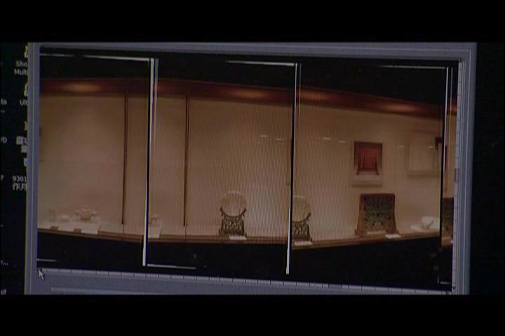
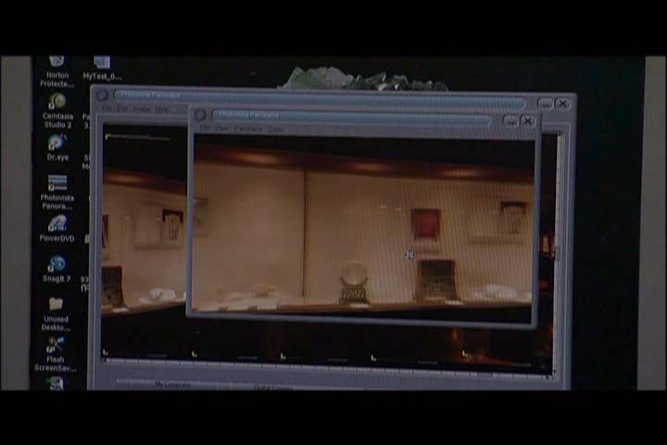
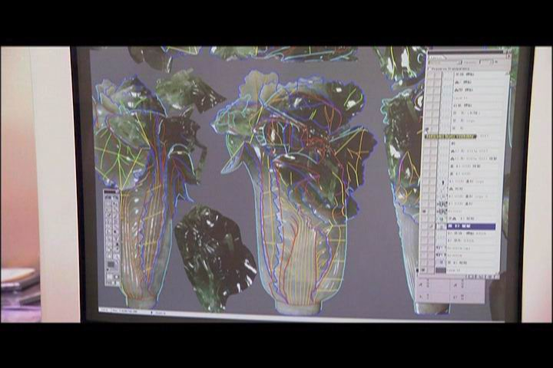
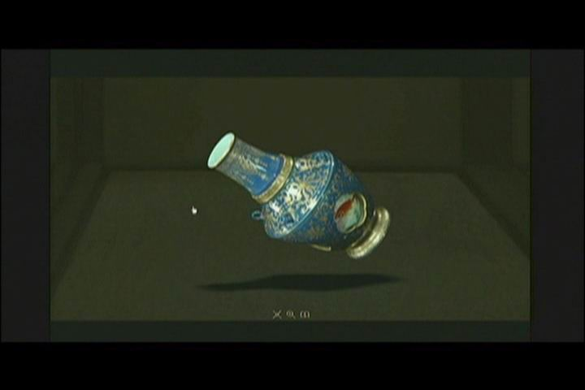
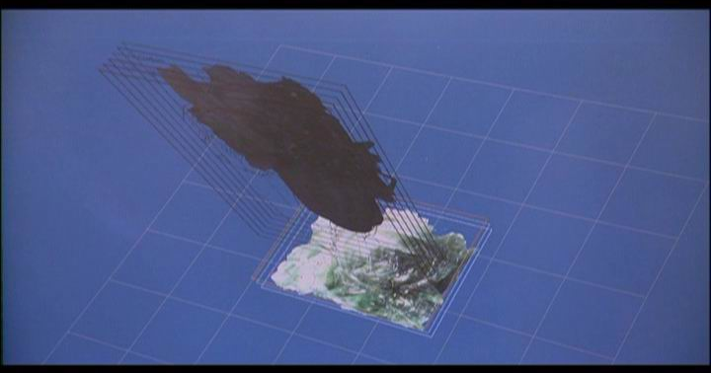
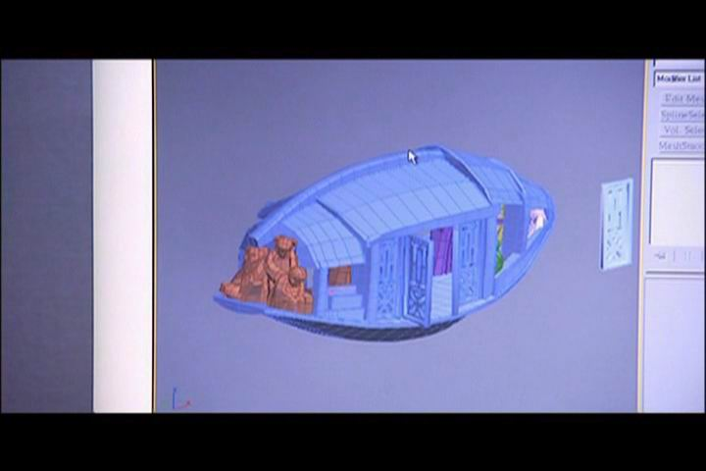
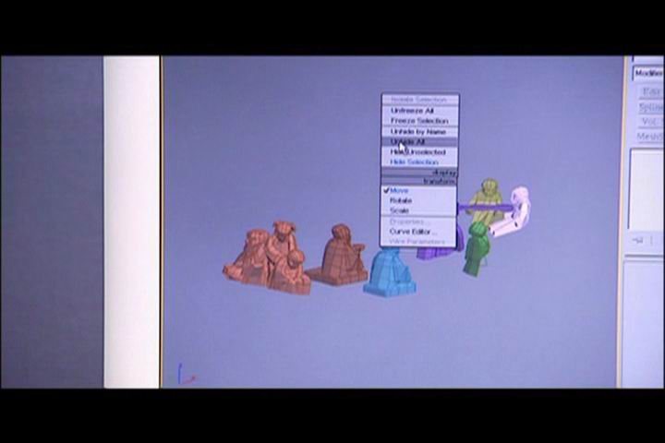
360度虛擬環場環景
建築構圖繪製白菜３Ｄ模型
以Maya製作3D模型

Slide 8
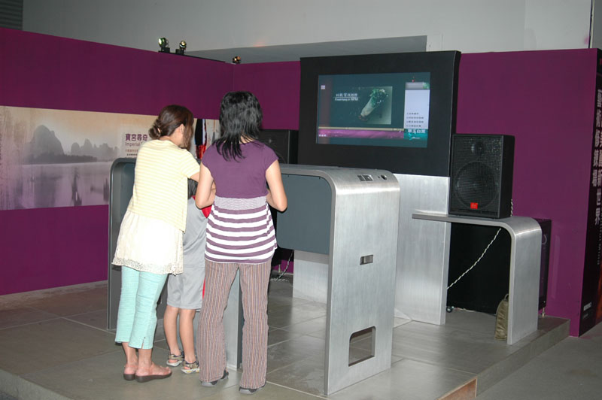
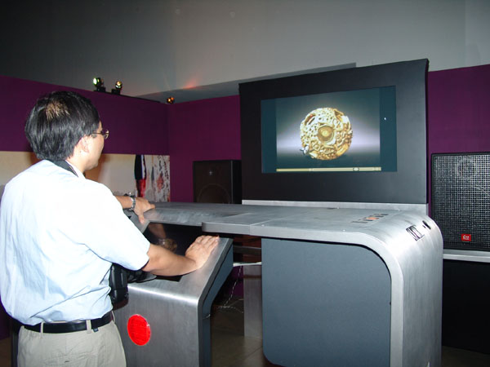
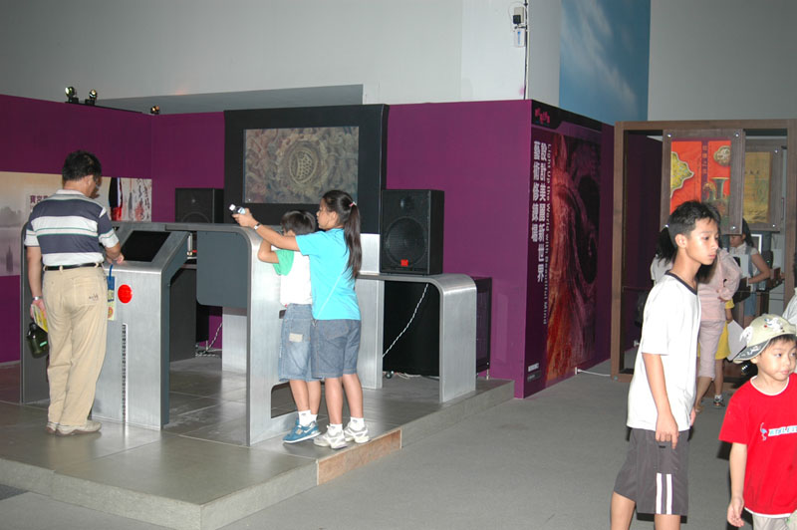
3D Virtual Exhibition System

Slide 9
Roaming through Fantasy Land 走入畫中 趙孟頫鵲華秋色

Slide 10
Roaming through Fantasy Land

Slide 11
Conclusion & Discussion
On-site Operation Management
Long waiting line
Equipment Maintenance
Contingency Management
Limit on Single User
User safety
Equipment Efficiency
Personal Hygiene
New User Experience
Surreal experience
Fly about vs. walk through
For museum Out-reaching
Limit on time and space
Installation and fine-tuning
What do users experienced?
Learning
Touching
Inspiring

